Slide 1
State of Play
of the Programme Implementation

Slide 2
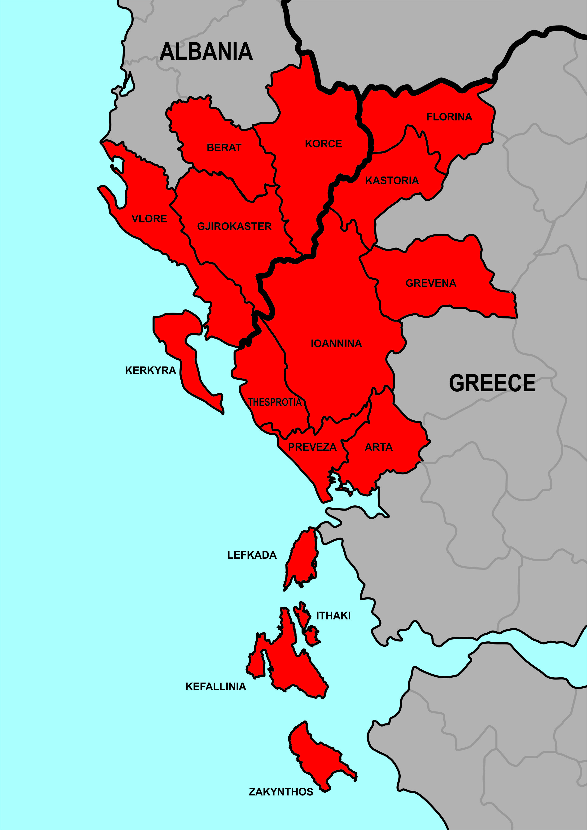
Project Closure Seminar – Tirana 06/07/2023

Slide 3
ΜΠΒ 85%
Εθνική Συμμετοχή 15%
Total Programme Budget:
54.076.734,00 €
From which IPA II 45.965.222 €
Project Closure Seminar – Tirana 06/07/2023

Slide 4
Priority Axis 1:
Promotion of the environment & sustainable infrastructure
Budget: 31,5M €
Priority Axis 2:
Boosting the local economy
Priority Axis 3:
Technical Assistance
Budget:19,3M €
Budget: 3,23M €
Project Closure Seminar – Tirana 06/07/2023

Slide 5
Priority Axis | Specific Objective | Budget (€)
1. Promotion of the environment & sustainable infrastructure | 1.1 Increase the capacity of CB infrastructure in transport, water & waste management | 20.829.212,00€
 | 1.2 Increase the effectiveness of environmental protection & sustainable use of natural resources | 1.149.200,00€
 | 1.3 Increase energy-efficiency and the use of RES | 7.258.824,00€
 | 1.4 Improve the effectiveness of risk prevention and disaster management with a focus on forest fires | 2.315.601,00€
2. Boosting the local economy | 2.1 Preserve cultural and natural resources as a prerequisite for tourism development of the cross border area | 14.320.005,00€
Ενίσχυση της τοπικής οικονομίας | 2.2 Improve cross-border capacity to support entrepreneurship, business survival and competitiveness | 4.972.689,00€
Project Closure Seminar – Tirana 06/07/2023

Slide 6
Approved Projects
Calls
5 Calls for Project Proposals
67 projects
Four (4) Strategic,
Fifty-nine (59) Ordinary,
Two (2) Targeted,
Two (2) ΤA
Twenty-Eight (28) projects under PA1
Thirty-Seven (37) projects under PA2
Two (2) projects under PA3
Total Budget: 67.906.876 €
Overbooking Percentage: 125,58%
Project Closure Seminar – Tirana 06/07/2023

Slide 7
a/a | Priori Axis | Programme Budget (a) | Approved Projects Budget (b) | Overbooking Percentage | Overbooking (b-a)
1 | Promotion of the environment & sustainable infrastructure | 31.552.837 | 40.823.838,87 | 129,38% | 9.271.001,87
2 | Boosting the local economy | 19.292.694 | 23.851.834,44 | 123,63% | 4.559.140,44
3 | Technical Assistance | 3.231.203 | 3.231.203,00 | 100,00% | 0,00
 | TOTALS | 54.076.734 | 67.906.876 | 125,58% | 13.830.142,31
Project Closure Seminar – Tirana 06/07/2023

Slide 8
a/a | Priori Axis | Programme Budget (€) | Approved Projects Budget (€) | Verifications* (€) * 14/06/2023 | Absorption Rate (%)
1 | Promotion of the environment & sustainable infrastructure | 31.552.837 | 40.823.838,87 | 20.188.861,69 | 63,98
2 | Boosting the local economy | 19.292.694 | 23.851.834,44 | 16.128.578,59 | 83,60
3 | Technical Assistance | 3.231.203 | 3.231.203,00 | 2.493.616,58 | 77,17
 | TOTALS | 54.076.734 | 67.906.876 | 38.811.056,86 | 71,77
Project Closure Seminar – Tirana 06/07/2023

Slide 9
9
Calls | Approved Projects Budget (€) | Verifications* (€) * 14/06/2023 | Absorption Rate (%)
Strategic Projects (1st Call) | 12.751.607,97 | 5.947.095,28 | 46,64%
Ordinary Projects (2nd Call) | 24.696.310,70 | 19.662.408,57 | 79,62%
Targeted Projects (3rd and 5th Calls) | 9.084.693,98 | 2.308.273,91 | 25,41%
Ordinary Projects (4th Call for 1.3 and 2.1 S.Os) | 18.180.863,61 | 8.399.662,52 | 46,20%
TOTALS | 64.713.476,26 | 36.317.440,28 | 56,12%
Project Closure Seminar – Tirana 06/07/2023

Slide 10
Thank you for your attention
Giorgos Papadopoulos
Head of Joint Secretariat Interreg IPA CBC Programme “Greece-Albania 2014-2020” +30 2310469685
gpapadopoulos@mou.gr

