Slide 1


Project Closure
on Management Information System (MIS)
Managing Authority Interreg 2021-2027
Joint Secretariat of the Interreg IPA CBC Programme “Greece – Albania 2014 – 2020 “
www.greece-albania.eu
www.interreg.gr

Slide 2
Closure Procedure
Submission of Table of Expenditures
(Beneficiaries)
1
Submission of Final Application Form
(Lead Beneficiary)
3
Decision Completion Letter
(Managing Authority)
4
Submission of Last Progress Report
(Lead Beneficiary)
2
(Submission of any final expenses)
(Beneficiaries)

Slide 3
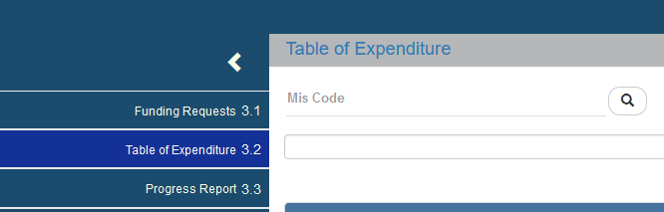
Creation of Table of Expenditures
Upload of invoices/documents
Correlations
Attachments
Submission of Table of Expenditures

Slide 4
Create a Table of Expenditure

Slide 5
Documents Entry
Expenditures
Invoice
Accounting Document
Staff paylist
Check
Electronic Payment
Bank transaction
Proof of Payment
Payments

Slide 6
What to enter as Subcontracting amount
Subcontracting amount” is related to the Payment Document
Not the correlations
If the total amount of the payment document, refers to other payments than the ones the beneficiary has paid for the project, then «Subcontracting amount» = «Amount paid for the project»

Slide 7
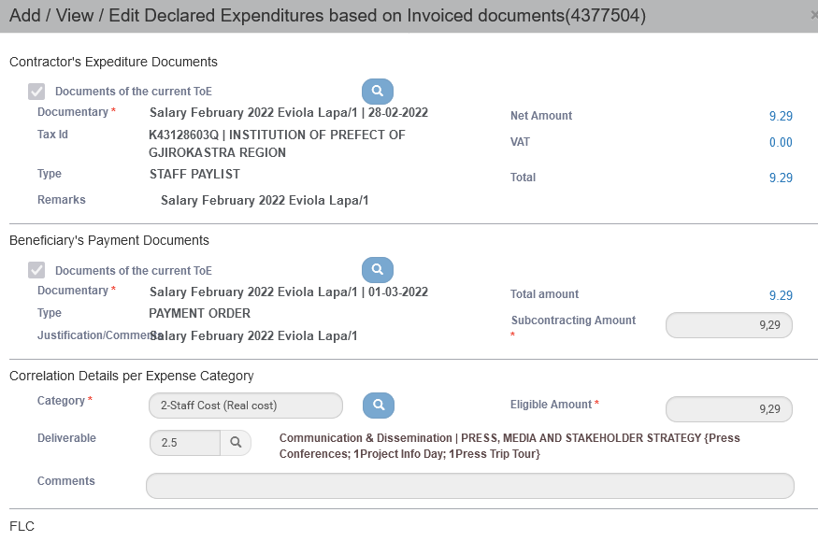
Every correlation is the “connection” of one invoice with one payment document for a specific deliverable and a specific budget category
Don’t write e.g. Del. 2.2.1, 2.2.2 etc

Slide 8
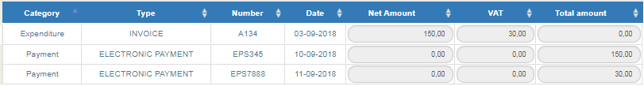
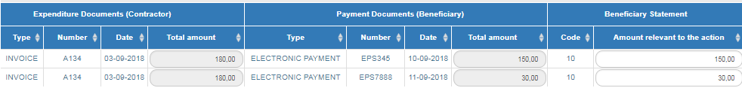
1. One invoice was paid by two separate checks
B1. Costs
B2. Correlations

Slide 9
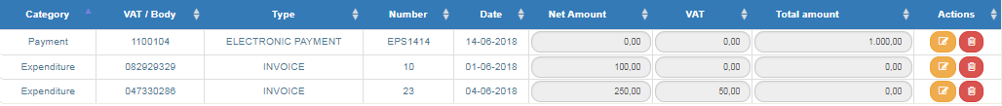
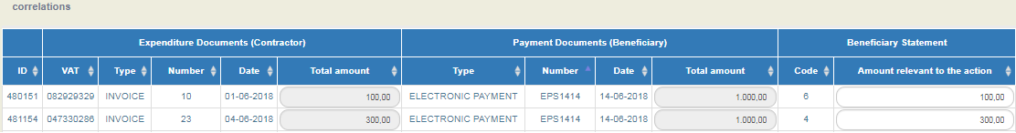
2. One payment document was used to pay two invoices
B1. Costs
B2. Correlations

Slide 10
3. Accounting Documents
Document
Correlations

Slide 11
4. Documents that were declared in previous Table of Expenditures 1/2
B1.Costs
B2. Correlations
* We do NOT enter again the Document
**we find and select the document entered in previous Table of Expenditures

Slide 12
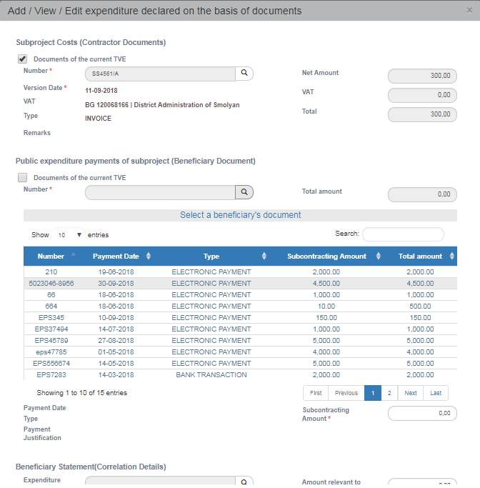
4. Documents that were declared in previous Table of Expenditures 2/2
2. Select Lense
1. Do not select «Documents of the current TVE»
3.Select from the list

Slide 13
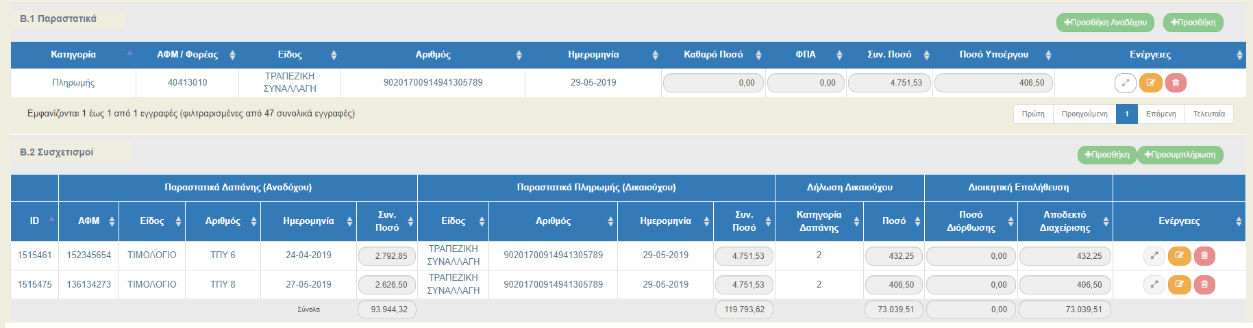

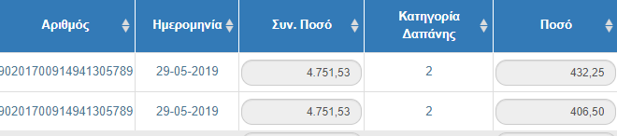
Possible Mistakes in «Subcontracting amount»
Τhe Subcontracting amount cannot be different in the correlations in the Tables of expenditure of the same beneficiary!!!

Slide 14
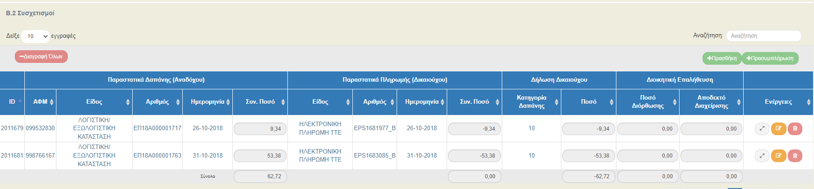
Possible Mistakes in “Correlations”
DO NOT correct amount of previously declared Table of Expenditures with negatives correlations!!!

Slide 15
Validation - Warnings
If the sum of the subcontracting amounts is more than the invoices (payments > invoices)
If the sum of the subcontracting amounts is higher than the approved budget (payments > approved budget)
CONTACT THE JOINT SECRATARIAT

Slide 16
Frequently asked Questions 1/2
Correction in No of Document or / and Date of Document
Correction of budget category or/and Deliverable
Contact Joint Secretariat
How can I make correction in Eligible amount?
Reply: This document must not be included in any correlation with another Table of Expenditure. Contact Joint Secretariat.
Reply: NOT POSSIBLE . If it is the case of an additional eligible amount, then an additional Table of expenditure should be created .
If the eligible amount should be decreased , contact the Joint Secretariat
Attention!! Do not decrease/ correct ‘Eligible amount by entering negative correlation in a following Table of expenditures

Slide 17
Frequently asked Questions 2/2
Cannot find the Taxation Number of the Contractor
Reply: This document is already entered in previous Table of Expenditures . If it is required to be used in a correlation, then it should be retrieved and added to “Correlations”
Attention!!! Do not change the name of the Document with symbols such as #*”” in order to differentiate it and enter it again at B1.Costs
I cannot enter a Document
Reply: Add Contractor and then the Document

Slide 18
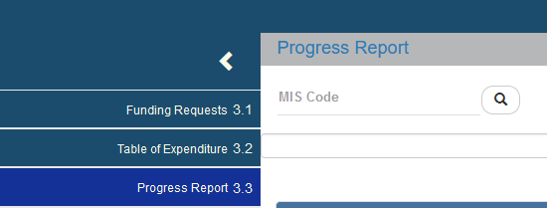
Submission of Last Progress Report

Slide 19

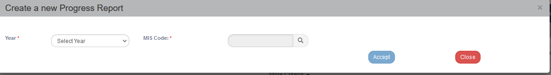
Create Last Progress Report
End Date of the project should be included in the reporting period

Slide 20
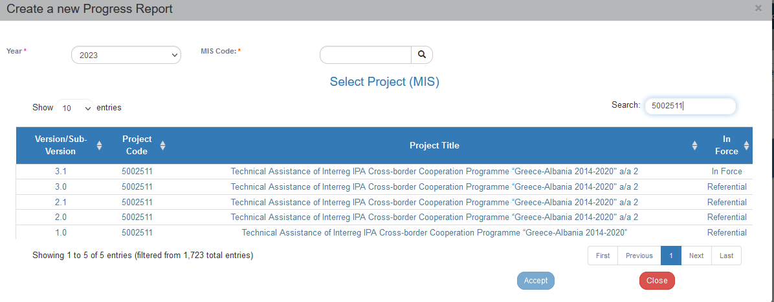
Create Last Progress Report
You choose the AF which is in force
Notes:
Κατά την δημιουργία του PR επιλέγουμε μόνο το έτος και στο τμήμα Α θα επιλέξουμε το εξάμηνο.
Είναι σημαντικό να επιλέγουμε για την δημιουργία πάντα από την λίστα το ΤΔΠ σε ΙΣΧΥ

Slide 21
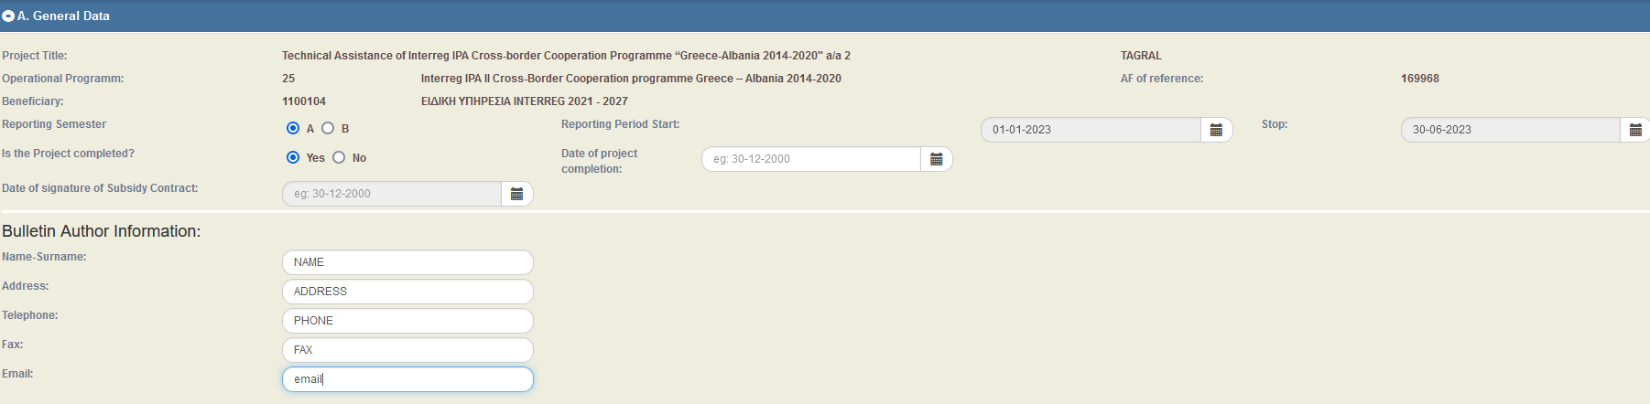
Create Last Progress Report
Select Reporting Semester
Select YES is the Project Completed
Enter end date
Enter all requested fields

Slide 22
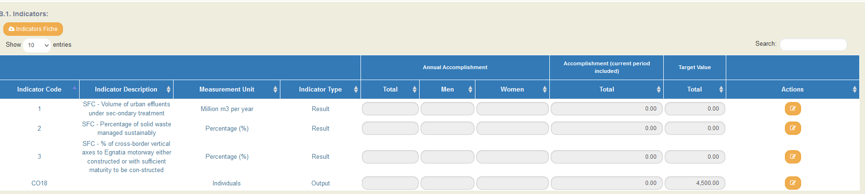
Indicators
Fill in the achieved value according the respective methodology
Notes:
Αυτό γίνεται πατώντας το πορτοκαλί κουμπί ,

Slide 23
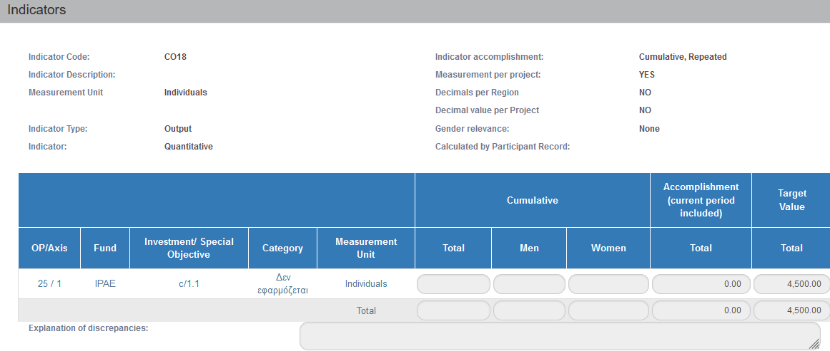
Indicators
Fill in the justification of achievement or discrepancy

Slide 24
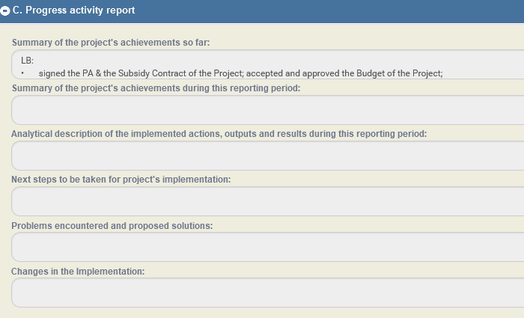
C. Activity report
Fill in the activity report

Slide 25
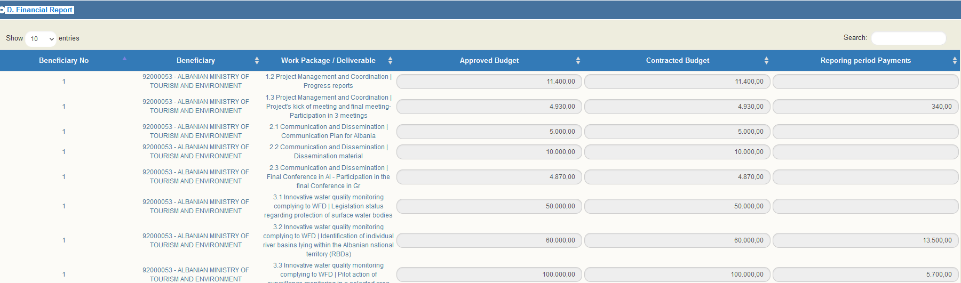
D. Financial Report
Fill in the contracted Budget
Fill in the Reporting Period Payments
Notes:
συμπληρώσει τις στήλες «Συμβασιοποιημένος Π/Υ» και «Πληρωμές Περιόδου». Ως προς τη στήλη «Συμβασιοποιημένος Π/Υ» συμπληρώνουμε το άθροισμα των ποσών των συμβάσεων που έχουν υπογραφεί για το σύνολο των κατηγοριών δαπάνης του συγκεκριμένου παραδοτέου. Για τη διευκόλυνση του υπολογισμού του αθροίσματος στο υποσύνολο των δαπανών της κατηγορίας «Προσωπικό» και στο υποσύνολο της κατηγορίας δαπάνης «Γενικά Έξοδα», αν δεν προκύπτει με σαφήνεια το ποσό της σύμβασης, χρησιμοποιούμε το ποσό που πρόκειται να δηλώσουμε ως επιλέξιμο για τη πράξη.

Slide 26

D. Financial Report
Fill in Deviations from the original plans, if necessary

Slide 27
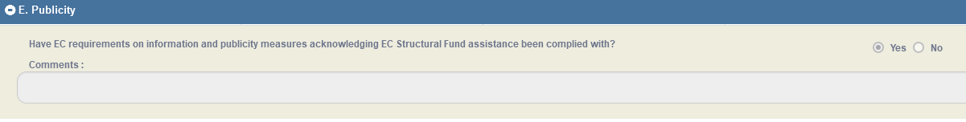
E. Publicity
Select YES in the question “Have EC requirements on information and publicity measures acknowledging EC Structural Fund assistance been complied with?”

Slide 28
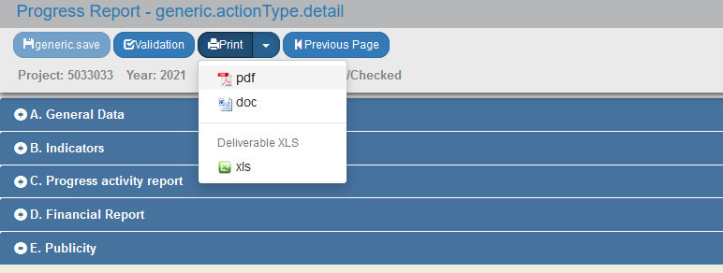
Printing Documents
Print necessary Documents

Slide 29
Printing_deliverables_pdf
7_Filled in by the user
8_Automatically filled in. It sums up Column (7) of the current PR + columns (7) of all the previous PRs which are Accepted/Checked
9_Sums up the amounts of the Tables of Expenditures which are at least “verified” within the reporting period of the current PR
10_ Sums up column (9) of the current PR + columns (9) of all the previous PRs which are Accepted/Checked
SECTION 4 – FINANCIAL REPORT
4.1 | Implementation of Actions
1 | 2 | 3 | 4 | 5 | 6 | 7 | 8 | 9 | 10
Benef. No | WP | Beneficiary No- | Deliverable | Approved | Contracted | Expenditure paid out during this reporting period | TOTAL | Verified Expenditure during this reporting period | TOTAL
 |  | Deliv.No | Title | Budget | Budget |  | Expenditure paid out including this reporting period |  | Verified Expenditure including this reporting period
 | 1 | Deliverable 1.1.2 | Project Management & Coordination | 16.480,80 | 16.249,92 | 3.445,35 | 15.149,80 | 12.528,01 | 15.149,74
LB
 | 1 | Deliverable 1.1.3 | Management Team & Technical Meetings | 1.933,00 | 500,00 | 77,03 | 450,30 | 77,03 | 450,03
LB
Notes:
Δεν πρέπει να είναι κόκκινα!
Στην εκτύπωση αυτή θα εμφανίζεται το σύνολο των επαληθευμένων δαπανών μόνο ΟΣΕΣ δαπάνες έχουν προλάβει να επαληθευτούν.

Slide 30
When was the last Table of Expenditures verified?
Before The verified amounts are calculated to the final progress report | Submission of the Final Progress Report | After The verified amounts are NOT calculated to the final progress report

Slide 31
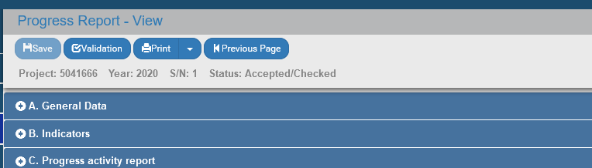
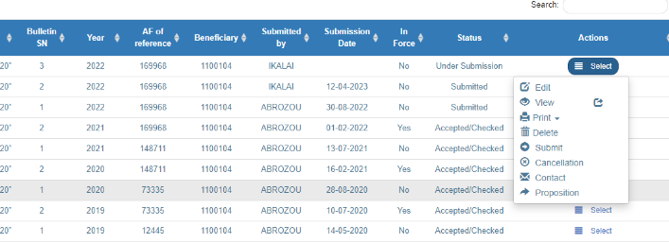
Validation
Submission of the final PR

Slide 32
Final Application Form
(for project completion)
Conditions for submission of AF for Project Completion by the LB
The Last Progress Report of the project is approved by the JS/MA
The total amount of the verified expenditures for all project beneficiaries is at least in the status "APPROVED“
There are no pending reports by the FLC or 2nd Level Control, for the whole partnership
there are no ‘open recommendations’

Slide 33
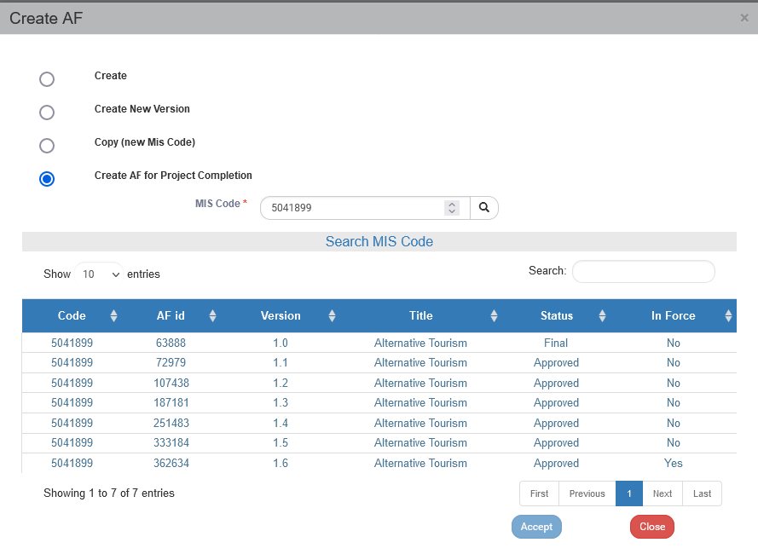
Creation of the final AF
Fill in the MIS code & select of the magnifying len
Select the AF which is in force, from the list
Accept
The AF is automatically created

Slide 34
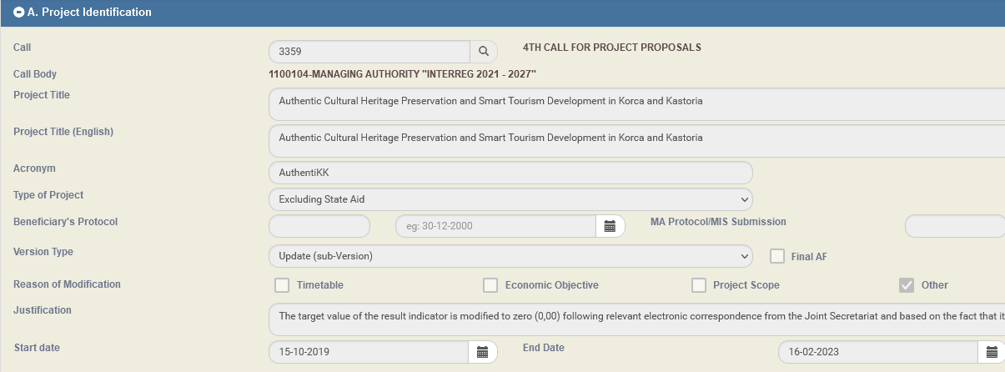
Section A_project identification
It is automatically filled in from the “in force” AF
The user updates data such as the “End Date” of the project
“Final AF” automatically filled in
Other” automatically filled in

Slide 35
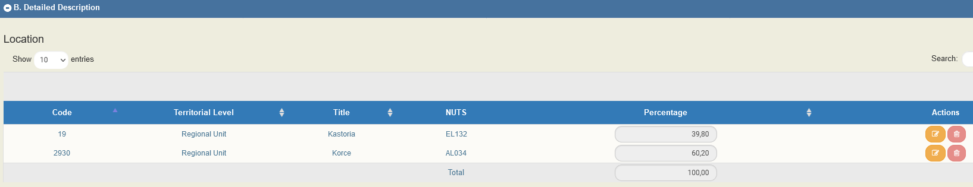
Section B_detailed description
It is automatically filled in from the “in force” AF
The user updates the percentages according to the approved expenditures per beneficiary

Slide 36
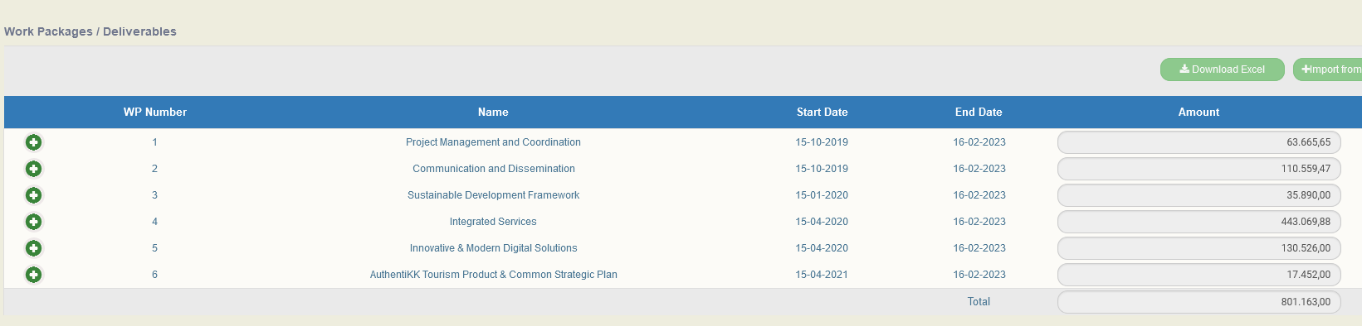
Section D_budget
The MIS, according to the verified expenditures, pre-fills in the following
WPs / Deliverables
Annual Allocation
Budget Allocation per budget line
Project financing
Budget per beneficiary
Budget = total verified expenditures.
The final budget should not incorporate any corrections from audit findings

Slide 37
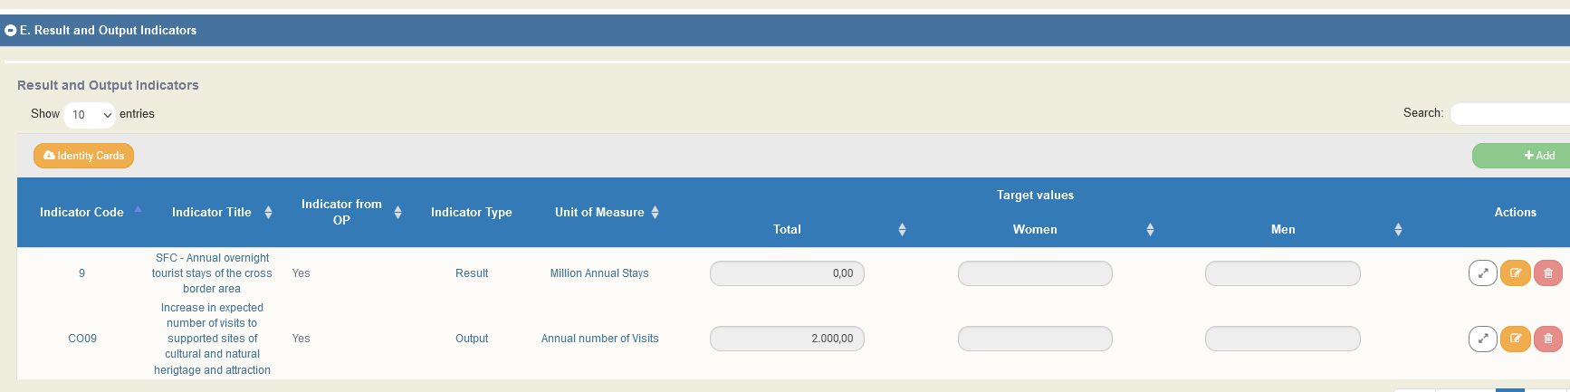
Section E_result and output indicators
It is automatically filled in from the “in force” AF
The beneficiary checks if any corrections are needed to the Target Value, according to the Final Project Report

Slide 38
Attachments
Section F_check list for submission
Choose YES at
“We solemnly declare that the information contained in the proposal is true and accurate”
Attach the Final Project Report
Beneficiary Comments
Fill in the URL where the deliverables are uploaded
BEFORE SUBMITTING THE AF, VALIDATE

Slide 39
Public Investment Programme _for the Greek Beneficiaries
Prerequisite for the project closure:
The budget per project and beneficiary at the Public Investment Programme to be equal to the final beneficiary’s budget (verified expenditures)

Slide 40
Thank you for your attention!

