Slide 1
Specification of Budget Costs
Joint Secretariat / Managing Authority of
Interreg IPA CBC Programme “Greece – Albania 2014 – 2020 “
www.greece-albania.eu
www.interreg.gr

Slide 2
Specification of Budget Costs
Important & Binding document
Has to be fully respected during implementation
Has to be uploaded on the MIS
New standard excel format
Generates the budget tables of the Application Form
Notifies the applicant of budget limit restrictions
Aim of this file:
to provide a wider and in-depth analysis of the budget stated in the Application Form

Slide 3
Technical Characteristics
It is an excel file, contains several functions!
Damaged files will not be accepted
It contains 10 different sheets:
COVER PAGE
1 sheet
BENEFICIARIES’ SECTION
1 sheet for each beneficiary
SUMMARY TABLES
3 sheets
AF Tables
Budget Check
The Beneficiaries’ section has been prepared for an average partnership consisting of 6 beneficiaries. In the framework of the 4rth Call eligible partnerships consist of up to 4 beneficiaries.
DO NOT DELETE THE ANY SHEETS

Slide 4
Specification of Budget Costs
Attention!
No deviations!!!
The sheet “AF TABLES” should be identical to the budget tables generated on the e-AF

Slide 5
COVER PAGE
The applicant fills in information regarding the Project and the Partnership (white cells)
Use the dropdown list where applicable
The grey cells are locked and completed either automatically either by the MA/JS

Slide 6
COVER PAGE

Slide 7
BENEFICIARIES’ SECTION
One sheet for each beneficiary
Each beneficiary sheet has a capacity of 200 lines for providing information regarding the expected costs
The applicant has to fill in the:
Descriptive part (columns WP, Deliverable, Budget Line, Item, Clarification of the Budget Items and Justification of estimated cost)
Calculations’ part (columns Quantity of item, time of item, cost per item)
General information such as Beneficiary, country, total sum are automatically generated
According to the selected budget line, there are different requirements of filling in the calculations’ columns

Slide 8
Filling in the Descriptive part
COLUMN | WHAT TO FILL IN
WP | Select the WP from a drop down list
Del. | Select the deliverable from a drop down list The applicant can select the deliverable only after the WP has been selected Decoding the number of each deliverable: 1st digit: number of WP 2nd digit: numbering of the beneficiary 3rd digit: number of deliverable
Budget Line | Select the budget line from a drop down list: Staff Costs Office and Administration Travel and Accommodation External Expertise and services Equipment Infrastructure and Works
Item | Select the item from a drop down list according to the budget line selected

Slide 9
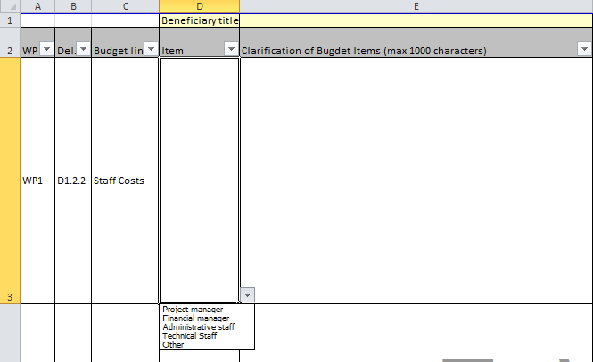
Filling in the Descriptive Part
Examples

Slide 10
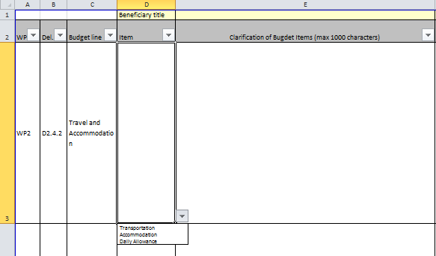
Filling in the Descriptive Part
Examples

Slide 11
Filling in the Descriptive Part
COLUMN | WHAT TO FILL IN
Clarification of Budget Items | According to the budget line and the item selected the beneficiaries should clearly describe the physical content of the item, the need of the item, the size etc. Up to 1000 characters
Justification of the Budget Costs | According to the budget line and the item selected the beneficiaries should clearly provide justification of the cost of the respective deliverable/item. The beneficiary should prove that the budget is realistic Up to 1000 characters
The applicants should consult TABLE 1, of the respective Guidebook in order to fill in correctly the SoBC and especially the Columns “Clarification of Budget Items” and “Justification of Budget Costs”

Slide 12
Filling in the Descriptive Part
Example – STAFF COSTS
Clarification of Budget Items | Justification of Estimated Costs
A brief description of the employee(s) and roles needed by the project should be provided. The description should answer the following questions: Role……(Project Manager)? Existing or new staff………….?. Working Status in the framework of the project (full time, part time, percentage)? Duties……….? | The applicant should state the gross amounts of the salaries, according to the rates currently applied in the beneficiary organization, justify the period of time charged for each person and specify the measurement unit (Man-hour, Man-day, Man-Month etc)

Slide 13
Filling in the Descriptive Part
Example – TRAVEL AND ACCOMODATION – TRANSPORTATION
Clarification of Budget Items | Justification of Estimated Costs
The Applicant, according to the item selected, must provide the relevant clarification. The description should answer at least, the following questions: Event /scope……………………? From…………………............. ? To………………………………… ? Transportation Means………? Km (not applicable if the transportation is by airplane/boat)……........ ? Number of people travelling ……? | The Applicant, according to the item selected, must provide the mathematical type with which the cost is being calculated and to justify the rate used at the “cost per item” column The description should answer at least the following questions: Number of trips… Number of tickets (if applicable) … OR Number of vehicles

Slide 14
Filling in the Descriptive Part
Example – EXTERNAL EXPERTISE
Clarification of Budget Items | Justification of Estimated Costs
The description should answer at least, the following questions: Content of the action……….…… Need of the action……………………. Beneficiary’s outputs (size, index, copies etc, where applicable)………………………………? Synergies with other deliverables…. | The Applicant should clearly explain every amount used per deliverable / sub-deliverable. The applicant should also state the number of the experts needed, their expertise and the duration of the service to be provided. Unit rate should be indicated

Slide 15
Filling in the Calculations’ Part
COLUMN | WHAT TO FILL IN
Quantity of item | According to the Budget line and item selected, the Applicant needs to include the quantity. This can be the number of personnel, trips, services, leaflets etc.
Time of item | Only applicable when the “Staff Costs” or the “Travel and Accommodation” budget lines are selected. According to the item selected the Applicant needs to select the duration of the item (i.e. days of daily allowances, Man days of a specific personnel, man-hours, etc)
Cost per item | According to the Budget line and the item selected, each Applicant needs to include the unit cost of a single item selected. This can be the rate of the personnel, the cost of a single trip, the cost of a single service, etc.
Total cost | Is the product of the following function: Quantity of Item X Time of item (where applicable) X Cost per item

Slide 16
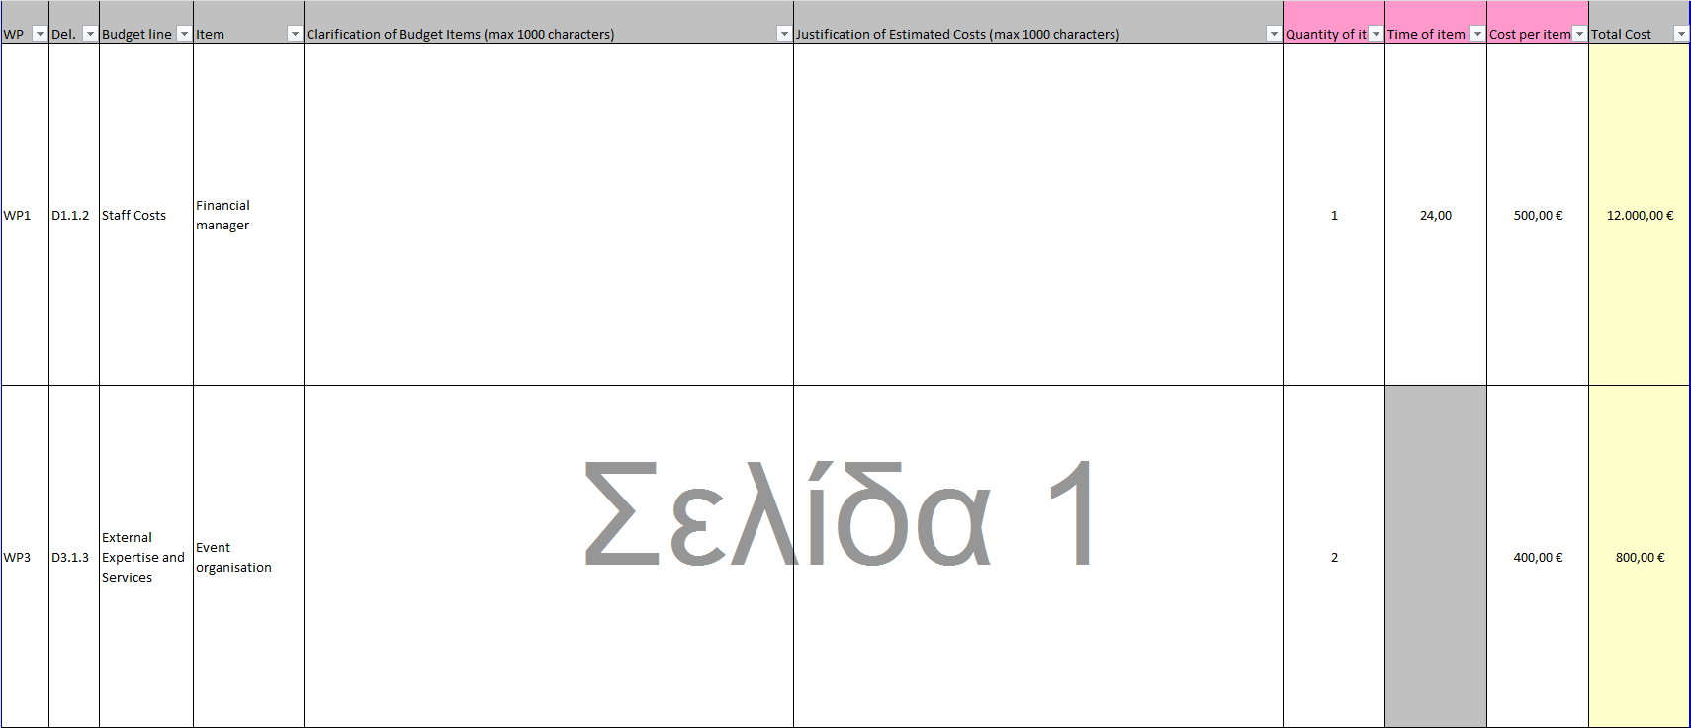
Filling in the Calculations’ Part

Slide 17
Summary Tables
Three (3) sheets:
“AF Tables”,
“Budget Check”
“Project Overview”
Automatically generated while filling in the Beneficiaries’ Section, thus no filling of information is required by the beneficiary

Slide 18
Summary Tables (AF Tables)
Contains Tables, one for each beneficiary, which have the same format as the budget tables of the Application form. The Tables need to be identical to those that will be included in the Application form
In case of mismatches between the tables of the SoBC and those of the Application form, the information of the Application form will be the one considered as valid

Slide 19
Summary Tables (AF Tables)

Slide 20
Summary Tables (Budget Check)
The sheet “Budget checks” monitors the budget of the project to be in accordance to the budget limits as set in the Call.
The sheet contains one table with the budget limits of the Call and one table calculating the critical parts (columns marked in green) of the Project budget. In case of budget limit violations, the green cells turn red.

Slide 21
Summary Tables (Budget Check)

Slide 22
Summary Tables (Project Overview)
The third sheet “Project Overview” provides more information regarding the budget allocation and balance of the project

Slide 23
Summary Tables (Project Overview)
Example

Slide 24
Printing of the SoBC
In the framework of the 4rth Call, the Project Proposals will be submitted electronically to the Programme’s Managing Authority/ Joint Secretariat (JS) via MIS.
Therefore the SoBC doesn’t have to be printed. In case an Applicant wishes to print the SoBC, for own use, it is recommended to minimize the size of the printed file by omitting the empty cells with the use of the active filter provided at the top of each table (click on the filter arrow and de-select the box of the (blank) lines). This way the applicant prevents the printing of any empty pages.

Slide 25
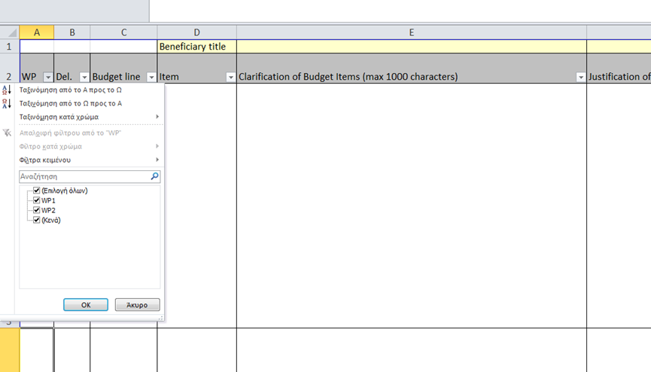
Printing of the SoBC
Click on the filter arrow of the WPs column
De-select the (Blanks)

Slide 26
General Information
Info days of the 4th call:
Vlora ,20/11/2018
Korca, 22/11/2018
Arta, 07/12/2018
For more information:
www.interreg.gr
www.greece-albania.eu
www.punetejashtme.gov.al

Slide 27
Thank you for your attention!
Joint Secretariat/Managing Authority of the
Interreg IPA II Cross-border Cooperation Programme “Greece - Albania 2014-2020”
Leof. Georgikis Scholis 65
570 01, Thessaloniki, Greece
Tel.: +30 2310 469680
Email: jts_gral@mou.gr

