Slide 1
INTERREG IPA CBC “GREECE ALBANIA 2014-2020”
- PART A -
Gjirokastër 04/06/2018
Korçë 06/06/2018

Slide 2
FIRST LEVEL CONTROL – GUIDELINES & PROCEDURES

Slide 3
PROJECT’S LIFE CYCLE - Financial and Information Flow
European Commission
Community Contribution
(85% of total verified budget)
Payment Claim
1st Level Control
Certifying Authority
Request for the verification of expenditure
Community Contribution per project
Verifications/
Certificates
Declaration of Verified expenditures through the MIS
Project partners
Verifications/
Certificates
Lead Partner
JS/MA
Community Contribution corresponding to project partners’ budget
Payments are made according to project’s implementation
Project partners

Slide 4
General Guidelines (1/8)
Regulation (EU) 1303/2013, Article 125 – Functions of the Managing Authority
Regulation (EU) 1299/2013, Article 23 – Functions of the Managing Authority
Regulation (EU) 447/2014 (for IPA countries)
Regulation (EU) 481/2014, specific rules on eligibility of expenditure for cooperation programmes
European Commission Guidance for Member States on Management Verifications (EGESIF_14_12_final - 17/9/2015)
Project Implementation Manual

Slide 5
General Guidelines (2/8)
1. Centralized System - Public FLC body at national or regional level
2. De-Centralized System -Private FLC body
GREECE
Decentralised System Register of Controllers
ALBANIA
Centralised System FLC Office at the Ministry for Europe and Foreign Affairs

Slide 6
General Guidelines (3/8)
According to Article 125 of Regulation (EU) 1303/2013
The Managing Authority must:
verify that:
the co-financed products and services have been delivered
that expenditure declared by the beneficiaries has been paid and
that it complies with applicable law, the operational programme and the conditions for support of the operation;
(b) ensure that:
beneficiaries involved in the implementation of operations reimbursed on the basis of eligible costs actually incurred, maintain either a separate accounting system or an adequate accounting code for all transactions relating to the operation

Slide 7
General Guidelines (4/8)
The verifications should cover in particular:
That expenditure relates to the eligible period and has been paid;
That the expenditure relates to an approved operation;
Compliance with National and Union eligibility and procurement rules;
Adequacy of supporting documents and existence of an adequate audit trail;
Compliance with State aid rules, sustainable development, equal opportunity and non-discrimination requirements;
The respect of EU and National rules on publicity;
Physical progress of the operation measured by common and Programme specific output and, where applicable, result indicators;

Slide 8
General Guidelines (5/8)
According to Article 125 of Regulation (EU) 1303/2013
Verifications shall include the following procedures:
administrative verifications of operations
on-the-spot verifications of operations

Slide 9
General Guidelines (6/8)
Administrative verifications during project implementation
All applications for reimbursement by beneficiaries, whether intermediate or final, shall be subject to administrative verifications based on an examination of the claim and relevant supporting documentation such as :

Slide 10
General Guidelines (7/8)
On the spot verifications
Effectiveness: On-the-spot verifications should be planned in advance to ensure that they are effective, in particular in view of the certification that the expenditure entered in the accounts complies with applicable law.
Availability: Generally, notification of the on-the-spot verifications should be given in order to ensure that the relevant staff (e.g. project manager, engineer, accountant) and documentation (in particular, financial records including bank statements and invoices) are made available by the beneficiary during the verification.

Slide 11
General Guidelines (8/8)
Administrative verifications
Management verifications of 100% of the applications for reimbursement submitted by beneficiaries are required by the Regulation CPR.
On-the-spot verifications
The intensity, frequency and coverage of on-the-spot verifications is dependent upon:
the complexity of the operation,
the amount of public support to an operation,
the level of risk identified by management verifications,
the extent of detailed checks during the administrative verifications and audits of the AA.

Slide 12
Procedures(1/9)
Beneficiary
Tender Documents
Invoices
FLC
Table of verified expenditure
Verifications Control Checklist
Bank statements
Table of verified expenditure
Verification Report
Certificate of verified expenditure
……

Slide 13
Procedures(2/9)
Common Documents
Guidance for Management verifications
Table of verified expenditure
Verifications Control Check list
Verification Report
Certificate of verified expenditure
Working Timesheet
Personnel Timesheet
Beneficiaries & FLCs
FLCs
Beneficiaries

Slide 14
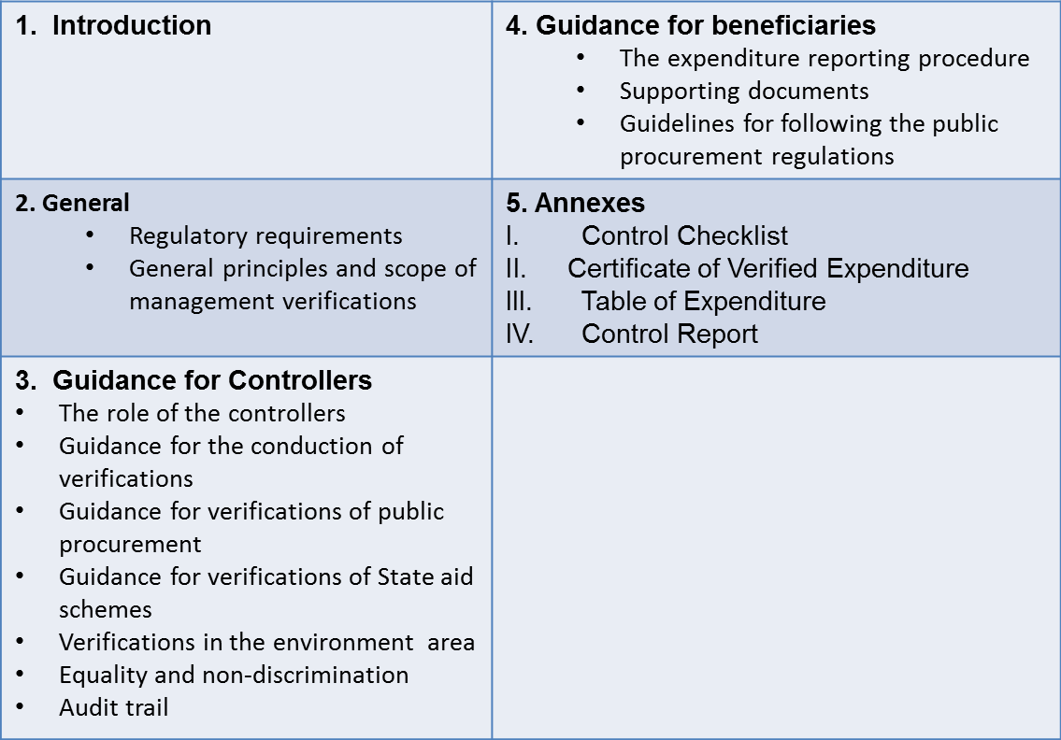
Procedures(3/9)
Guidance on management verifications

Slide 15
Procedures(4/9)
Table of verified expenditure
Beneficiary’s information
Contractor’s payment documents
Beneficiary’s payment documents
FLC results

Slide 16
Procedures(5/9)
Verification Control Check list
Beneficiary Information
Audit trail of Project documents
Audit Trail Checklist of expenditure
Categories of eligible expenditure
Compliance with information and publicity requirements
Compliance with public procurement rules
Compliance with EU policies
Physical Implementation
Fraud Indication
Recommendations

Slide 17
Procedures(6/9)
Verification Report
Information on project and progress report
Information on Designated Controller
Verification methodology
Expenditure declared and certified by budget line
Description of findings during on the spot check
Conclusions and recommendations

Slide 18
Procedures(7/9)
Certificate of verified expenditure
Information for the project and progress report
Information for the Beneficiary
Verification / certified amount
3. Verification
Methodology | desk-based on-the-spot
Date(s) of on-the-spot verification | DD.MM.YYYY - DD.MM.YYYY
Amount certified | Total certified EUR | IPA in EUR | National contribution in EUR

Slide 19
Procedures(8/9)
Working Timesheet
General Information for the personnel
Working hour per day and deliverable
Hourly rate
Requested amount per deliverable
Total requested amount for the specific application for reimbursement
Signatures by the employee and the responsible supervising person

Slide 20
Procedures(9/9)
Personnel Timesheet
General Information for the personnel
Working hour per day and beneficiary’s project
Hourly rate
Requested amount per project
Total requested amount for the specific application for reimbursement
Signatures by the employee and the responsible supervising person

Slide 21
(1/4)
Each Beneficiary (Lead or Project) submits electronically a request for the verification of expenditure to the respecting FLC body of each country, which is accompanied by a file with all proper documentation. The Beneficiary enters the expenditure data in predefined MIS screens that include the project data, but also uploads specific documents, which are in fact the verification file (e.g. tender documents, proof of publicity actions, invoices, payments, receipts etc.).
Also, each Beneficiary fills in the “Table of Expenditure” in a predefined MIS form. In this stage, the MIS conducts a series of logical validation checks (e.g. the declared expenditure of a specific deliverable, or/and a specific type of cost don’t exceed the approved budget in the AF).

Slide 22
(2/4)
The Controllers proceed to the administrative check of the above file (when it is complete).
The Controller fills in the “Table of Expenditure” in the MIS Screen with the verified and not verified expenditure amounts.
The Controller fills in the “Verification control checklist” in a predefined MIS Screen.
Finally, the Controller fills in the “Verification Report” in a predefined MIS Screen.
The Controller prints for signature the above mentioned 4 documents through the MIS and submit them to the partner, according to “Programme implementation manual”.

Slide 23
(3/4)
The MA/JS, in order a payment application to be done, checks/validates the relevant data which have submitted by the Controller, through a specific MIS Screen.
The Certifying Authority will be able to draw, through a specific MIS Screen, the table of eligible verified expenditure per budget line that will include in the following payment application to the European Commission. The payment applications per accounting year, are made on the basis of the validated by the MA expenditure, within the accounting year.

Slide 24
(4/4)
The submission data MUST be correct, on-time and detailed
The submitted data concern:
The beneficiary (legal framework, VAT status, declarations, organization chart, methodology of indirect cost calculation, etc.)
Project’s data (Application Form, Subsidy Contract, Partnership Agreement, declarations, management team definition, etc.)
Application’s for verification data (tender procurements, contracts, invoices, payments, staff time sheets, etc.)

Slide 25
Procedures for Greek Partners(1/2)
The first time, the Beneficiary submits to the Unit C of the MA a complete file of the paid-out expenditure and supporting documentation. From the second submission for expenditure verification and onwards, the beneficiary submits all documentation to the selected controller and cc to Unit C of MA
The Beneficiaries shall submit their applications for expenditure verification at least every semester/trimester and preferably whenever the expenditure exceeds 15.000€

Slide 26
Procedures for Greek Partners(2/2)
The Controller, within 5 working days from the day he/she receives the electronic file (or 7 working days after the end of the on-the-spot verification) shall issue and submit to the Beneficiary by e-mail, copying to Unit C, the relevant FLC documents
The Beneficiary can submit an objection within five (5) working days after receiving the aforementioned documents
The Controller, within five (5) working days after receiving the objection, examines the objection and the accompanying documentation and submits the final Verification Certificate

Slide 27
UNIT C “VERIFICATION OF EXPENDITURES”
MANAGING AUTHORITY OF EUROPEAN TERRITORIAL COOPERATION PROGRAMMES
Tel: +30 2310 469 600, 469 620, 469 614, 469 622, 469 672
Fax:+30 2310 469 602
e-mail: kxristodoulou@mou.gr, dkaravatos@mou.gr, tsalonidis@mou.gr , dvoutira@mou.gr

